Slide 1
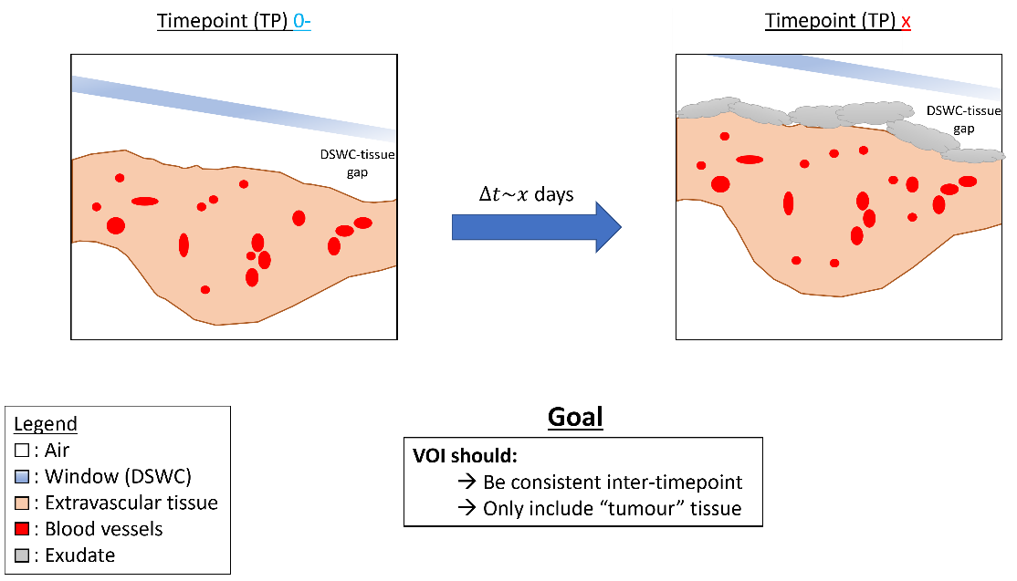
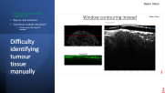
Semi-auto volume of interest (VOI) definition
Nader Allam
Notes:
Biggest initial issue is identifying tumour tissue so at the very least

Slide 2
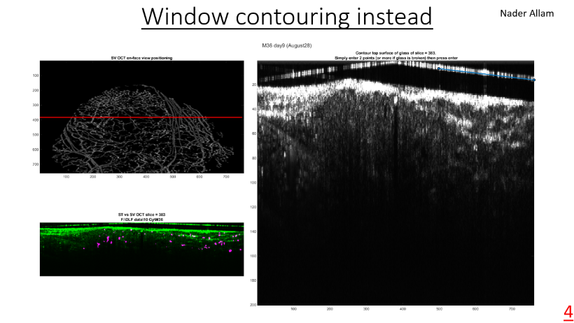
Difficulty identifying tumour tissue manually
Nader Allam
Important for comparability longitudinally
Rely on clear interfaces
Sometimes multiple interfaces?
Porous avascular layer→ exudate
2
Notes:
(remove all above first interface if no clear )

Slide 3
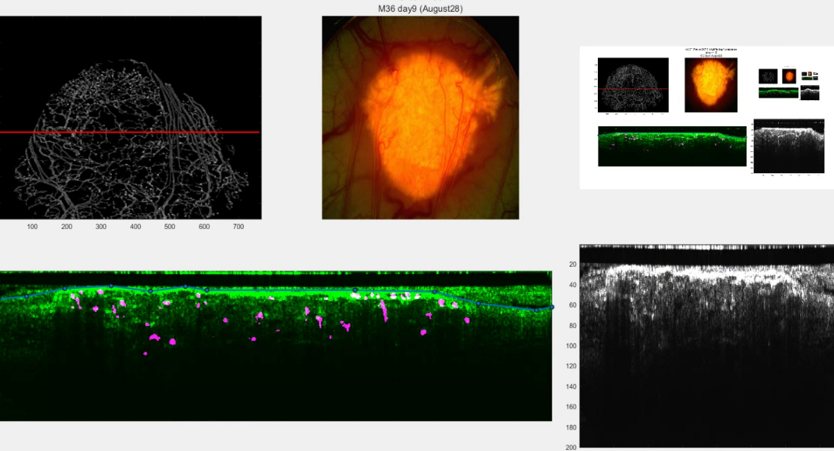
Nader Allam
To reduce inter-timepoint variability
Contouring of corresponding B-scan from near timepoint
Tracing position along binarized svOCT
Brightfield/fluorescence image
Overlay of binarized svOCT on aligned stOCT for contouring of considered B-scan
stOCT of considered B-scan
3
Notes:
This will have an even simpler implementation with the automati positioning setup, as FOV identical and coregistered from the start (no need to try to manually position every time and try to replicate FOV)

Slide 4
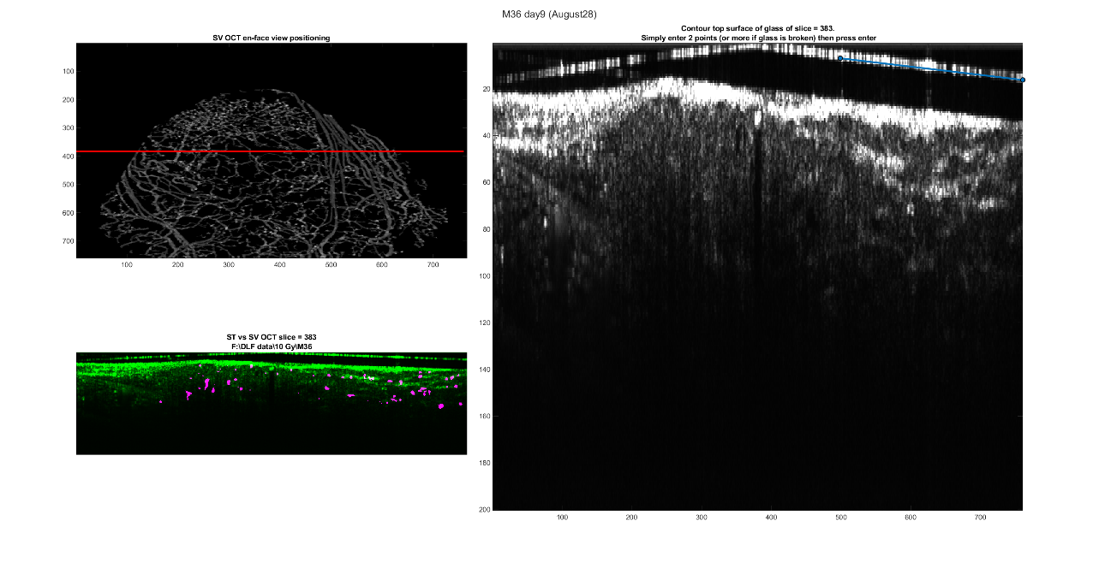
Window contouring instead
Nader Allam
4

Slide 5
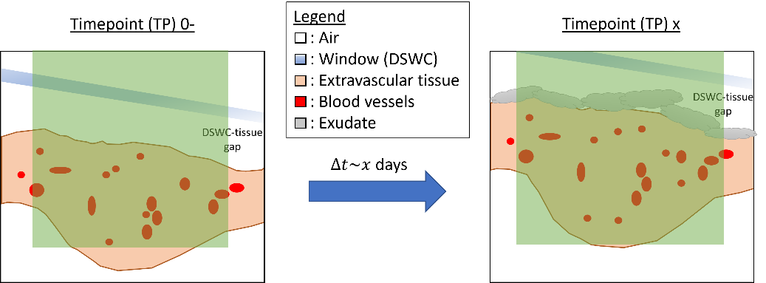
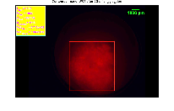
Nader Allam
Repeatability
Accuracy
Mask definition methods (analysis to fixed depth):
Cylindrical projection of 2D lateral contour
Fluorescence / brightfield image reference
5
Cylindrical projection of 2D lateral contour
Tissue interface contour in depth at each TP + Method 1
Glass interface contour in depth at each TP + Method 1
Method 1+3 + cropping down to level of most superficial vessel based on TP0-
Method 1+3 + cropping down to co-registered TP0- tissue interface

Slide 6
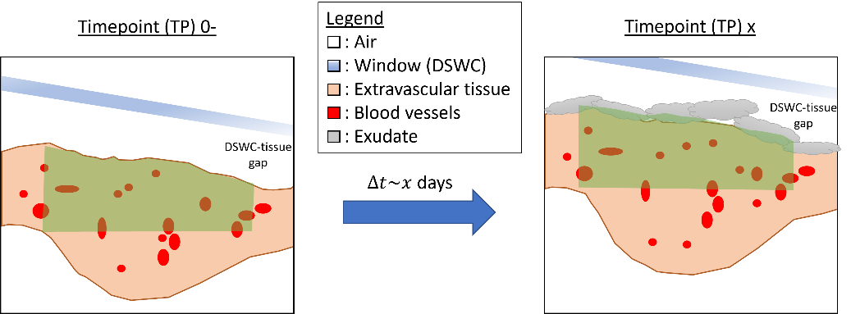
Nader Allam
Repeatability
Accuracy
Mask definition methods (analysis to fixed depth):
Cylindrical projection of 2D lateral contour
Tissue interface contour in depth at each TP + Method 1
Fluorescence / brightfield image reference
6
Cylindrical projection of 2D lateral contour
Tissue interface contour in depth at each TP + Method 1
Glass interface contour in depth at each TP + Method 1
Method 1+3 + cropping down to level of most superficial vessel based on TP0-
Method 1+3 + cropping down to co-registered TP0- tissue interface

Slide 7
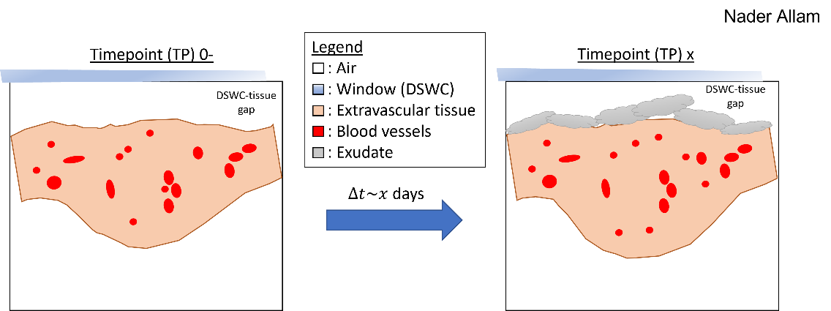
Repeatability
Accuracy
Mask definition methods:
Cylindrical projection of 2D lateral contour
DSWC interface contour in depth at each TP + Method 1
Tissue interface contour in depth at each TP + Method 1
7
Cylindrical projection of 2D lateral contour
Tissue interface contour in depth at each TP + Method 1
Glass interface contour in depth at each TP + Method 1
Method 1+3 + cropping down to level of most superficial vessel based on TP0-
Method 1+3 + cropping down to co-registered TP0- tissue interface

Slide 8
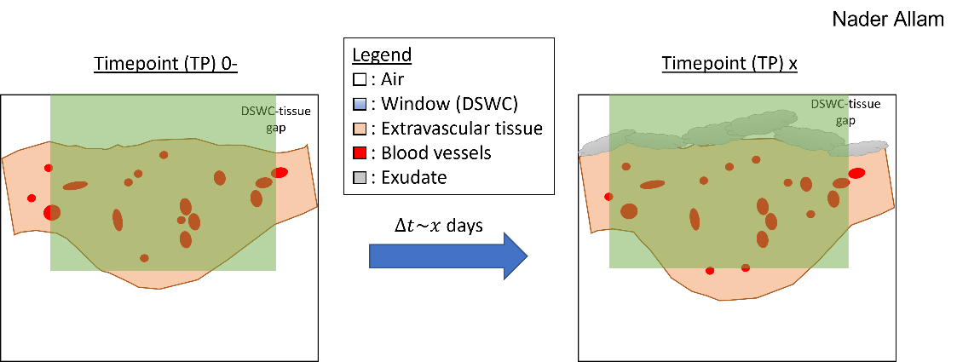
Repeatability
Accuracy
Mask definition methods:
Cylindrical projection of 2D lateral contour
DSWC interface contour in depth at each TP + Method 1
Tissue interface contour in depth at each TP + Method 1
8
Cylindrical projection of 2D lateral contour
Tissue interface contour in depth at each TP + Method 1
Glass interface contour in depth at each TP + Method 1
Method 1+3 + cropping down to level of most superficial vessel based on TP0-
Method 1+3 + cropping down to co-registered TP0- tissue interface

Slide 9
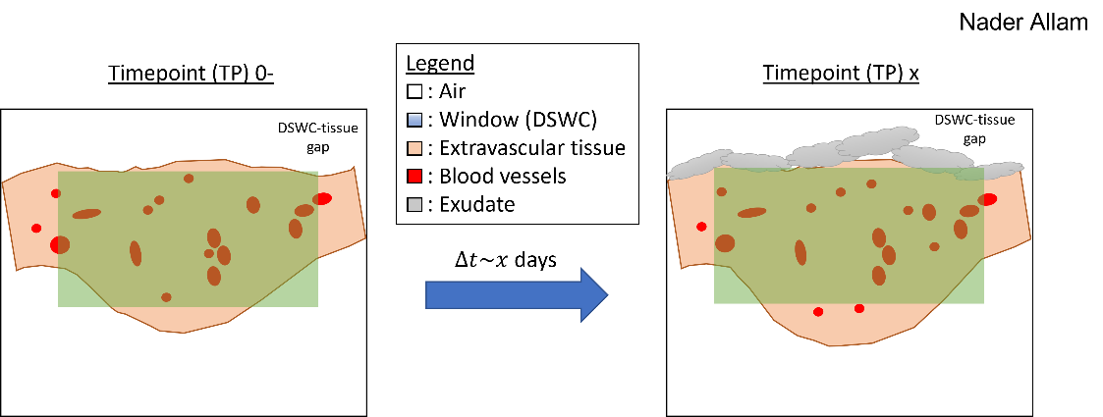
Repeatability
Accuracy
Mask definition methods:
Cylindrical projection of 2D lateral contour
DSWC interface contour in depth at each TP + Method 1
Method 1+2 + cropping down to level of most superficial vessel based on TP0-
Tissue interface contour in depth at each TP + Method 1
9
Cylindrical projection of 2D lateral contour
Tissue interface contour in depth at each TP + Method 1
Glass interface contour in depth at each TP + Method 1
Method 1+3 + cropping down to level of most superficial vessel based on TP0-
Method 1+3 + cropping down to co-registered TP0- tissue interface

Slide 10
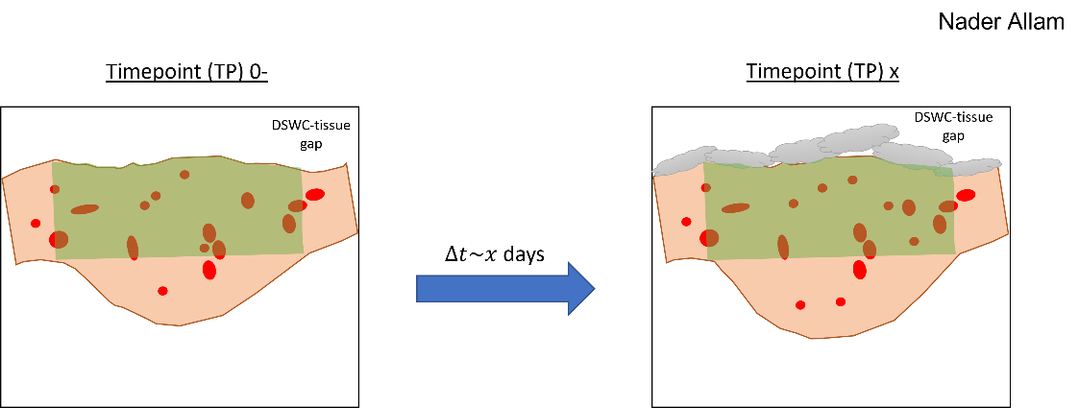
Repeatability
Accuracy
Mask definition methods:
Cylindrical projection of 2D lateral contour
DSWC interface contour in depth at each TP + Method 1
Method 1+2 + cropping down to level of most superficial vessel based on TP0-
Method 1+2 + cropping down to co-registered TP0- tissue interface
Tissue interface contour in depth at each TP + Method 1
10
Cylindrical projection of 2D lateral contour
Tissue interface contour in depth at each TP + Method 1
Glass interface contour in depth at each TP + Method 1
Method 1+3 + cropping down to level of most superficial vessel based on TP0-
Method 1+3 + cropping down to co-registered TP0- tissue interface
Notes:
Must still crop out glass for co-registration to TP0

Slide 11

Current tissue masking method (4)
Nader Allam
Transversely:
Otsu’s method or manual trace
Fluorescence / brightfield image reference
11

Slide 12

Current tissue masking method (4)
Nader Allam
Timepoint (TP) 0-
Timepoint (TP) x
DSWC-tissue gap
In Depth:
$∆t\sim x$ days
Legend
: Air
: DSWC (Window)
: Extravascular tissue
: Blood vessels
: Exudate
(TP⁰⁻ DSWC mask)
(TP^{x} DSWC mask co-registered in 3D to TP⁰⁻)
(TP⁰⁻ Tissue mask)
“General” DSWC-tissue gap 3D shape
(“General” DSWC-tissue gap 3D shape)
~ TP^{x} tissue mask

